Slide 1
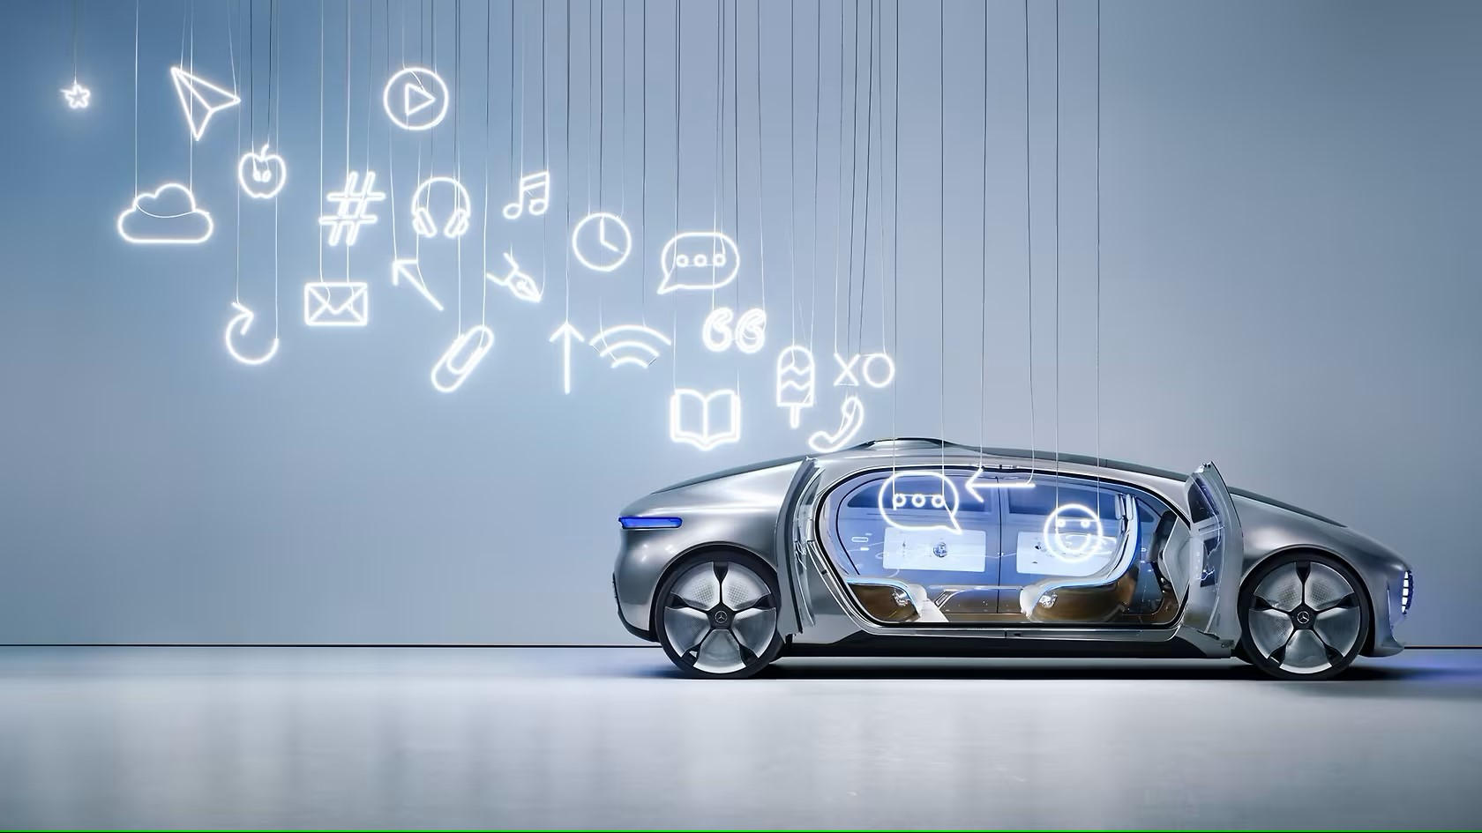



Slide 2
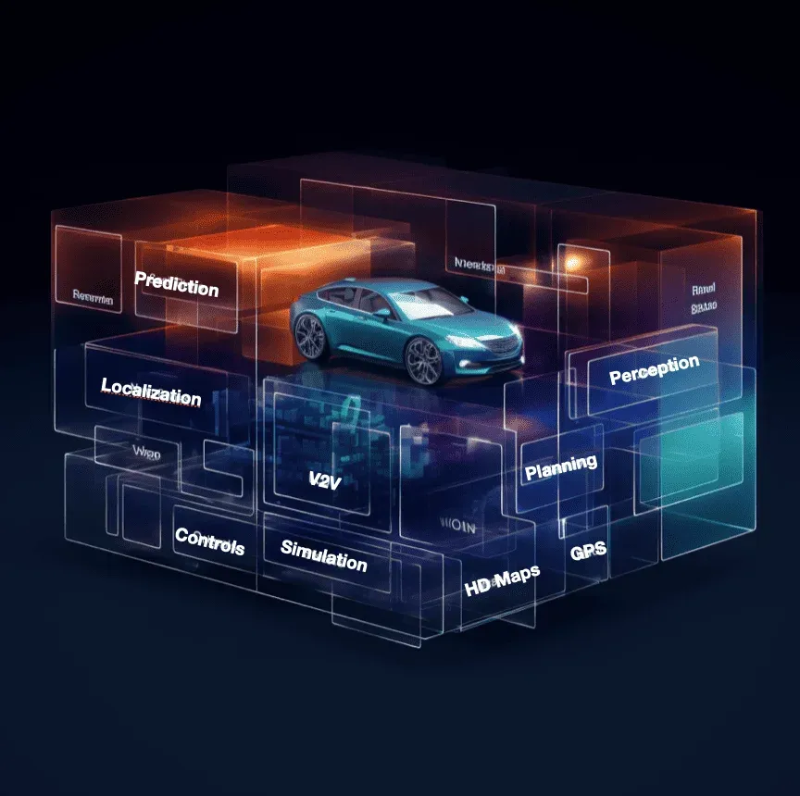
What is Autonomous cars ?
An autonomous car is a vehicle capable of sensing its environment and operating without human involvement.

Slide 3
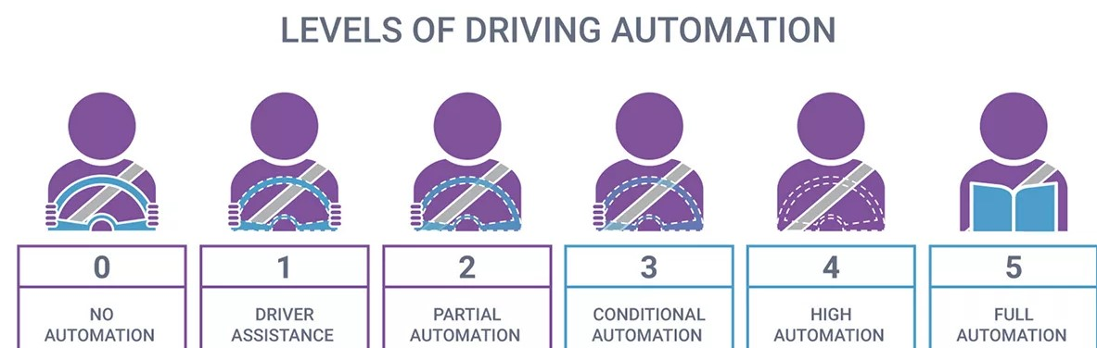
Levels of Autonomous cars:
There are categorized into six levels by the SAE (Society of Automotive Engineers) from level 0 to level 5, have been adopted by the U.S. Department of Transportation.

Slide 4
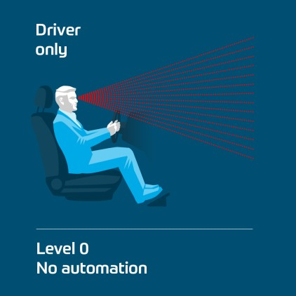

Level 0:
No Driving Automation
The driver steers, brakes and accelerates without the support of assistance systems. The human provides the "dynamic driving task" although there may be systems in place to help the driver.

Slide 5
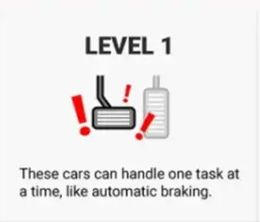
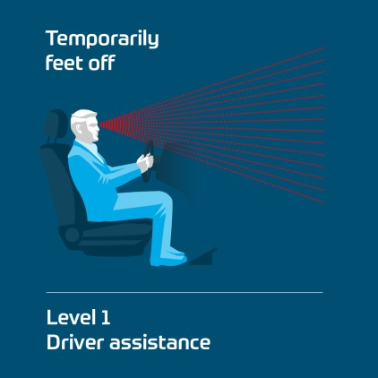
Level 1:
Driver Assistance
The vehicle has the capacity to perform one and only one autonomous task at any given time. The vehicle features a single automated system for driver assistance, such as steering or accelerating (cruise control).

Slide 6
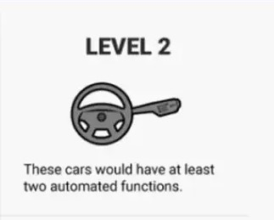
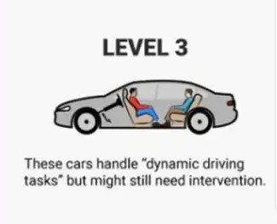
Level 2 :
Partial Driving Automation
The vehicle can control both steering and accelerating/decelerating. Here the automation falls short of self-driving because a human sits in the driver's seat and can take control of the car at any time.
Level 3 :
Conditional Driving Automation
The vehicle takes over the driving duties in specific scenarios, allowing drivers to rest or focus on other activities during these periods, thus reducing driver fatigue.

Slide 7
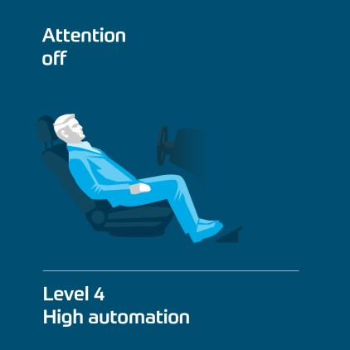
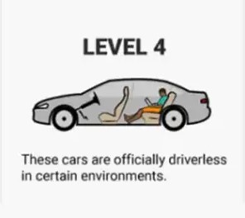
Level 4 :
High Driving Automation
The vehicle operates completely autonomously under certain conditions. The human being no longer has to be ready to intervene. He can work, watch movies and even sleep. And the vehicle may also drive alone, i.e. without occupants.

Slide 8
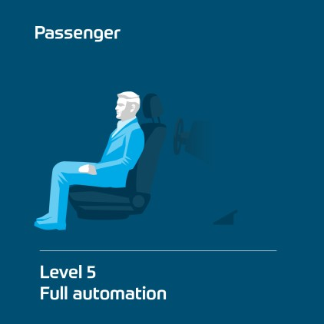
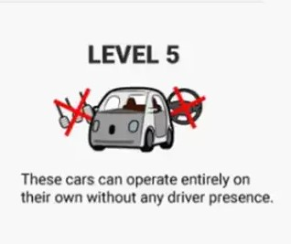
Level 5 :
Full Driving Automotive
The vehicle can drive anywhere in road traffic and under all conditions without human beings. Consequently, these vehicles do not require a steering wheel or a gas or brake pedal. A human driver no longer exists at this stage.

Slide 9
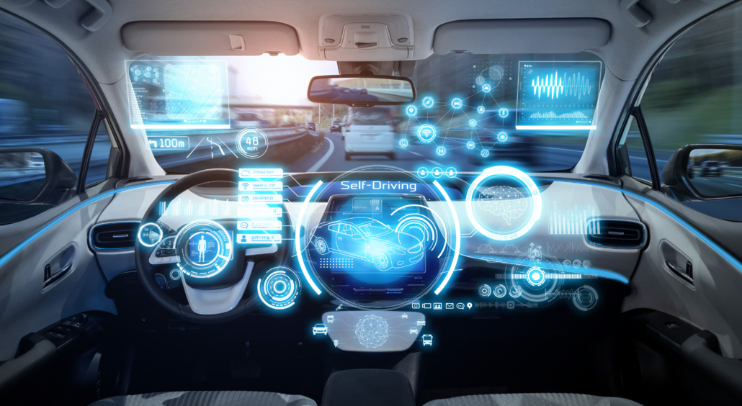
Autonomous vs. Automated vs. Self-Driving: What’s the Difference?
In general the Society of Automotive Engineers call
autonomous cars as Automated cars. One reason
is that the word autonomy has implications
beyond the electromechanical. A fully autonomous
car would be self-aware and capable of making its
own choices
Self-Driving means the car was controlling by the user
by the device/controller. In this self-driving cars human
need was necessary to drive the car .

Slide 10
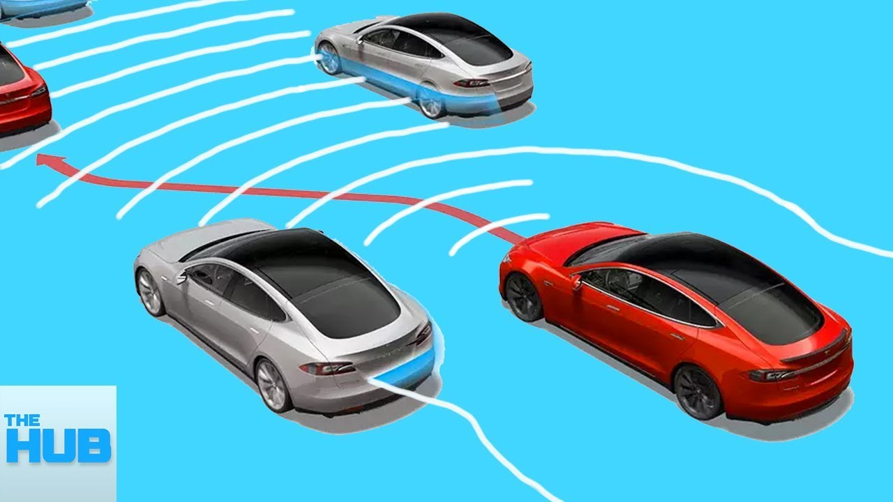
How Do Autonomous Cars Work?
Autonomous cars rely on sensors, actuators, complex algorithms, machine learning systems, and powerful processors to execute software.

Slide 11
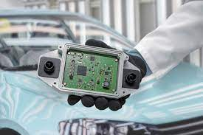

Radar is a key component of the suite of perception sensors used for safe and reliable navigation of autonomous vehicles. Its unique capabilities include high-resolution velocity imaging, detection of agents in occlusion and over long ranges, and robust performance in adverse weather conditions.
Video cameras detect traffic lights, read road signs, track other vehicles, and look for pedestrians.
sensors bounce pulses of light off the car’s surroundings to measure distances, detect road edges, and identify lane markings.
Ultrasonic sensors in the wheels detect curbs and other vehicles when parking.
Radar sensor
Lidar sensor

Slide 12
Sophisticated software then processes all this sensory input, plots a path, and sends instructions to the car’s actuators, which control acceleration, braking, and steering. Hard-coded rules, obstacle avoidance algorithms, predictive modeling, and object recognition help the software follow traffic rules and navigate obstacles.

Slide 13
What Are The Benefits Of Autonomous Cars?
Accidents will be decreased
Reduce traffic congestion
Free up parking lots for other uses
Reduce urban CO2
Reduce traffic congestion
(30% fewer vehicles on the road)
Accidents will be reduced
Cut transportation costs by 40%
(in terms of vehicles, fuel, and infrastructure)
Improve walkability and livability
Free up parking lots for other uses
(schools, parks, community centers)
Reduce urban CO2 emissions by 80% worldwide

Slide 14
Thank you!

